Slide 1



Understanding
Your Financial
Standing
ISE 583

Slide 2
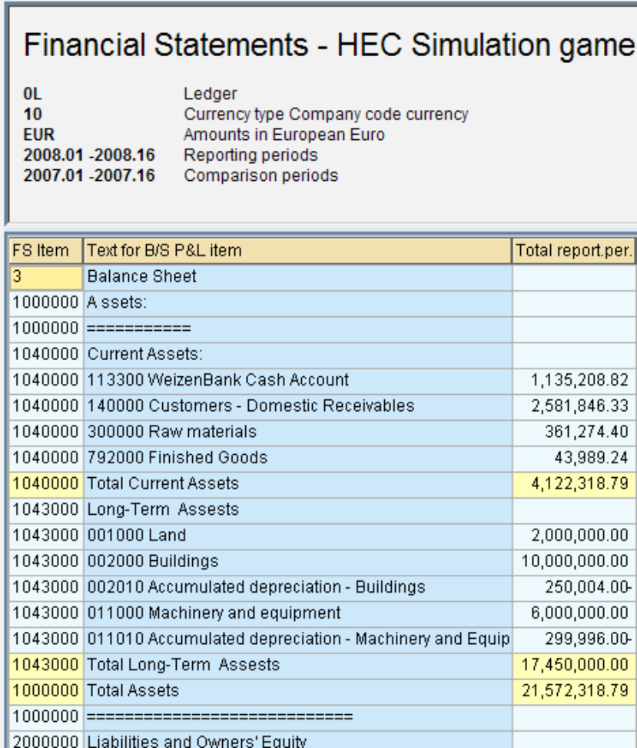
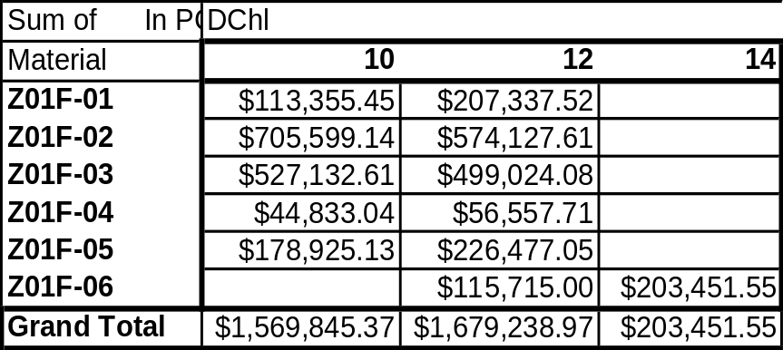
Have You Checked Your Financials Today?
Transaction F.01
  Select ALV Grid Control then export to MS Excel
Transaction KE5Z
  Specify appropriate Profit Center (quarter), modify the current layout, then export to local file
Sample

Slide 3
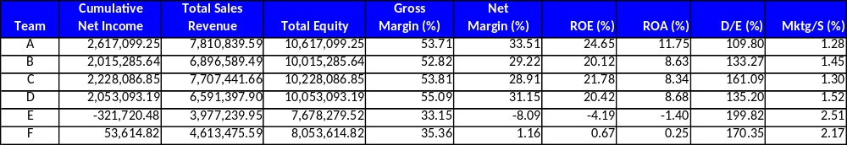
Current Financial Standings
Various measurements can be used to evaluate the financial health, stability, and profitability of a company:
Financial Standing after Rnd-1
Sample

Slide 4
Company Valuation
Company Valuation is a measure of performance which is linked to profit and credit rating (risk).
where
Annual Profit
Discounting Risk Rate
Company Valuation =
Cumulative
Net Income
(Setup)¹
Annual Profit =
x 12 + (Setup)¹
No. of Rounds Played
and
Discounting Risk Rate = Risk Premium² + 7%³
¹ Note: The Setup investment is a negative number
² Risk Premium is determined by your Credit Rating (refer to the chart on the notes page.)
³ 7% is historically the average market risk rate
Notes:
Credit Ratings, Interest and Risk Premiums:

Slide 5
Financial Terms
Equity is the amount of money you have tied up in an asset or your company. From transaction F.01
  Shareholder’s Equity (common stock)
  + Net income (retained earnings)
  Total Equity
Gross Profit Margin is used to assess the profitability of a firm’s core activities excluding fixed costs. A high gross profit margin indicates that a business can make a reasonable profit on sales.
Revenue – Cost of Goods Sold
Revenue
Gross margin =
Notes:
Equity is the amount of money you have tied up in an asset. This could be the amount you own/have paid off on a house. You can use the equity as collateral to borrow against.
From transaction F.01
Shareholder’s Equity or common stock
+ Net income (retained earnings) .
Total Equity
Gross Profit Margin is used to assess the profitability of a firm’s core activities excluding fixed costs. A high gross profit margin indicates that a business can make a reasonable profit on sales as long as it keeps overhead costs in control.
Revenue – Cost of Sales
Revenue
Gross Margin =

Slide 6
Financial Terms (cont.)
Net Profit Margin is a measure of profitability after including fixed costs. A low profit margin indicates a low margin of safety; a decline in sales will erase profits and result in a net loss
ROE measures the rate or return on the ownership interest of the common stock owners. It measures the efficiency at generating profit from every dollar of shareholder’s equity
Net Income (after taxes)
Sales Revenue
Net margin =
Net Income
(Net Income + Total Equity)
ROE =
Notes:
Net Profit Margin – a measure of profitability after including fixed costs. A low profit margin indicates a low margin of safety; higher risk that a decline in sales will erase profits and result in a net loss.
Profit margin is an indicator of a company's pricing policies and its ability to control costs.
Net Profit (after taxes)
Net Sales
Differences in competitive strategies and product mix cause net profit margin to vary among different companies and is therefore usually used for internal comparison.
ROE – Return on Equity measures the rate of return on the ownership interest of the common stock owners.
ROE is viewed as one of the most important financial ratios.
It measures the efficiency at generating profit from every dollar of net assets (assets minus liabilities).
It shows how well a company uses investment dollars (common stock) to generate earnings growth
Net Income
Total Equity
Some industries have high ROE because they require no assets, such as consulting firms. Other industries require large infrastructure builds before they generate a penny of profit, such as oil refineries. You cannot conclude that consulting firms are better investments than refiners just because of their ROE. Generally, capital-intensive businesses have high barriers to entry, which limit competition. But high-ROE firms with small asset bases have lower barriers to entry. Thus, such firms face more business risk because competitors can replicate their success without having to obtain much outside funding. As with many financial ratios, ROE is best used to compare companies in the same industry.
Net Margin =
ROE =

Slide 7
Financial Terms (cont.)
ROA shows how profitable a company's assets are in generating revenue; how many dollars of earnings the company derives from each dollar of assets.
Debt to Equity is a measure of Risk.
Marketing / Sales indicates the effectiveness of advertising expenditures on sales.
Net Income
Total Assets
ROA =
Total Liabilities
(Net Income + Total Equity)
D/E =
Marketing Expense
Sales Revenue
Mktg / S =
Notes:
ROA – shows how profitable a company's assets are in generating revenue; how many dollars of earnings the company derive from each dollar of assets.
Net Income
Total Equity
ROE is an indicator of how profitable a company is before leverage (borrowing money to supplement existing funds for investment)
This is useful for comparing competing companies in the same industry. A good example is comparing the performance of banks.
Companies that require large initial investments will generally have lower return on assets.
Debt to Equity is a measure of Risk.
Liabilities (Debt)
Shareholder’s Equity
There is debate upon the composition of “Debt”; whether or not to include all debt, not just long term debt, and whether or not to include accounts payable as part of the debt.
Most financial economist and academic papers usually refer to all liabilities as debt; D/E = (A-E)/E
ROA =
D/E =

Slide 8
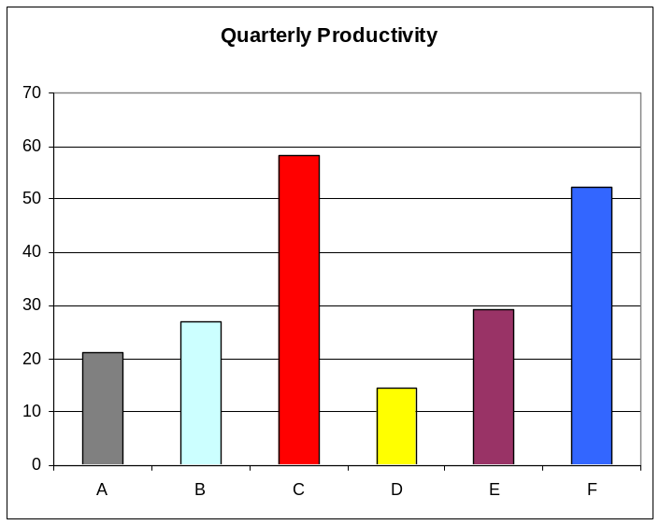
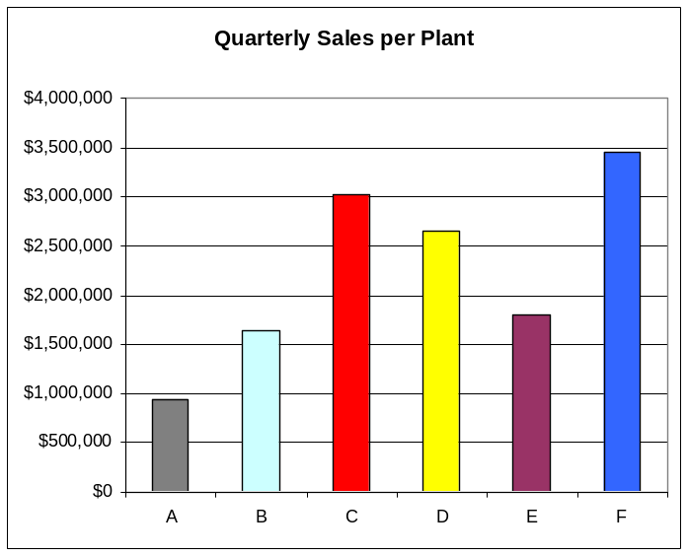
Current Financial Standings
Sample
The charts below would be created from other ERP reports, but
you can see how the results coincide with the financials above.
Notes:
Equity is the amount of money you have tied up in an asset. This could be the amount you own/have paid off on a house. You can use the equity as collateral to borrow against.
From transaction F.01
Shareholder’s Equity or common stock
+ Net income (retained earnings) .
Total Equity
Net Profit Margin – a measure of profitability after including fixed costs. A low profit margin indicates a low margin of safety; higher risk that a decline in sales will erase profits and result in a net loss.
Profit margin is an indicator of a company's pricing policies and its ability to control costs.
Net Profit (after taxes)
Net Sales
ROE – Return on Equity measures the rate of return on the ownership interest of the common stock owners.
It measures the efficiency at generating profit from every dollar of net assets (assets minus liabilities).
It shows how well a company uses investment dollars (common stock) to generate earnings growth
Net Income
Total Equity

